Slide 1
ROS
AMRITA VISHWA VIDYAPEETHAM School of Engineering,- Dept .of Computer Science & Engineering

Slide 2
ROS
As the name says, ROS is not a real operating system.
It is a meta operating system that provides some operating system functionalities.
These functionalities include multithreading, low-level device control, package management, and hardware abstraction.
The hardware abstraction layer enables programmers to program a device.
The advantage is that we can write code for a sensor that works the same way with different vendors.
So, we don’t need to rewrite the code when we use a new sensor. Package management helps users organize software in units called packages.
Each package has source code, configuration files, or data files for a specific task. These packages can be distributed and installed on other computers.
AMRITA VISHWA VIDYAPEETHAM School of Engineering,- Dept .of Computer Science & Engineering

Slide 3
Key Components of Robot Operating System (ROS)
ROS Master: The ROS Master provides name registration and lookup to the rest of the nodes in the ROS system. It allows nodes to find each other and establish communication.
ROS Nodes: Nodes are the basic executable units in ROS. Each node is responsible for a specific task and can run independently, communicate with other nodes, and be distributed across multiple machines.
ROS Topics: Topics are used for unidirectional, asynchronous communication between nodes. Nodes publish messages to topics, and other nodes subscribe to these topics to receive the messages.
AMRITA VISHWA VIDYAPEETHAM School of Engineering,- Dept .of Computer Science & Engineering

Slide 4
ROS Services: Services allow for synchronous communication between nodes. A service consists of a pair of messages: one for the request and one for the response.
ROS Parameters: The parameter server allows nodes to store and retrieve parameters at runtime. Parameters are often used to configure nodes and store static data such as configuration settings.
ROS Bags: ROS bags are a format for recording and playing back ROS message data. This is useful for logging sensor data, debugging, and analyzing system performance.
AMRITA VISHWA VIDYAPEETHAM School of Engineering,- Dept .of Computer Science & Engineering

Slide 5
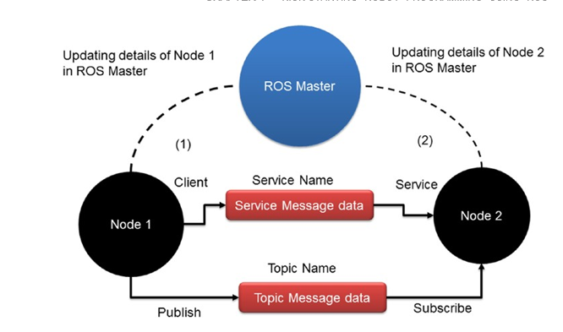
AMRITA VISHWA VIDYAPEETHAM School of Engineering,- Dept .of Computer Science & Engineering

Slide 6
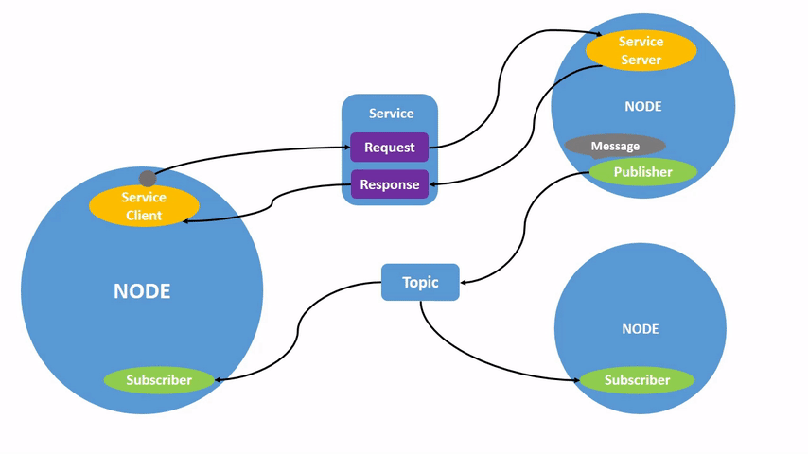
AMRITA VISHWA VIDYAPEETHAM School of Engineering,- Dept .of Computer Science & Engineering

